Slide 1

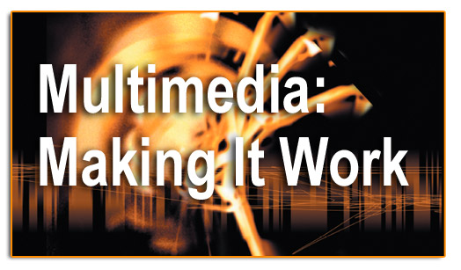
Lesson 7-Animation

Slide 2
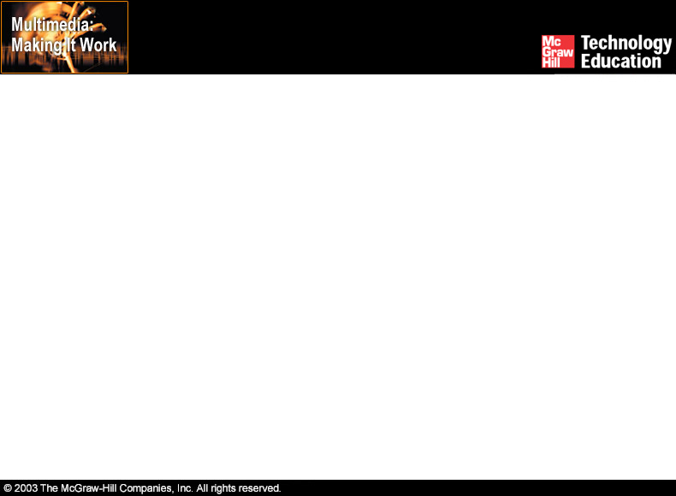
Overview
Introduction to animation.
Computer-generated animation.
File formats used in animation.
Making successful animations.

Slide 3
Introduction to Animation
Animation is defined as the act of making something come alive.
It is concerned with the visual or aesthetic aspect of the project.
Animation is an object moving across or into or out of the screen.

Slide 4
Introduction to Animation
Animation is possible because of a biological phenomenon known as persistence of vision and a psychological phenomenon called phi.
In animation, a series of images are rapidly changed to create an illusion of movement.

Slide 5
Computer-Generated Animation
Animation space.
Animation techniques.

Slide 6
Animation Space
Animation can be rendered in:
  2-D space - 2-D animations are very simple and static.
  2-1/2D space - An illusion of depth is created through shadowing, highlighting, and forced perspective, though in reality the image rests in two dimensions.
  3-D space - Complicated and realistic animations are done in 3-D space.

Slide 7
Animation Techniques
Animation process.
Cel animation.
Computer animation.

Slide 8
Animation Process
The steps to be followed in creating animation are:
  Organize the execution in a series of logical steps.
  Choose an animation tool best suited for the job.
  Build and tweak the sequences.
  Post-process the completed animation.

Slide 9
Cel Animation
Cel animation is a technique in which a series of progressively different graphics are used on each frame of movie film.
The term "cel" is derived from the clear celluloid sheets that were used for drawing each frame.
Cel animation begins with keyframes.

Slide 10
Cel Animation
Keyframes refer to the first and the last frame of an action.
The frames in between the keyframes are drawn in the tweening process.
Tweening depicts the action that takes place between keyframes.
Tweening is followed by the pencil test.

Slide 11
Computer Animation
Computer animation is very similar to cel animation.
The primary difference is in how much must be drawn by the animator and how much is automatically generated by the software.

Slide 12
Computer Animation
Kinematics is the study of the movement and motion of structures that have joints.
Inverse kinematics is the process of linking objects, and defining their relationship and limits.
Morphing is an effect in which a still or moving image is transformed into another.

Slide 13
File Formats used in Animation
.dir and .dcr - Director files.
.fli and .flc - AnimatorPro files.
.max - 3D Studio Max files.
.pics - SuperCard and Director files.
.fla and .swf - Flash files.

Slide 14
File Formats used in Animation
GIF89a file format:
  It is a version of the GIF image format.
  GIF89a allows multiple images to be put into a single file and then be displayed as an animation in the Web browser.
  Applications like BoxTop Software's GIFmation or ULead's GIF Animator are needed to create GIF89a animation.

Slide 15
Making Successful Animations
Use animation carefully and sparingly.
High quality animations require superior display platforms and hardware, as well as raw computing horsepower.
File compression is very important when preparing animation files for the Web.

Slide 16
Making Successful Animations
Some animation tools are:
  Macromedia's Flash.
  Kai's Power Tools' Spheroid Designer.
  Alias|Wavefront's Maya.
  NewTek's Lightwave.

Slide 17
Summary
Animation is visual change over time and adds great power to multimedia.
Cell animation uses a series of progressively different graphics on each frame of movie film.
Computer animation has eased the process of creating animation.
Many file formats are designed specifically to contain animation.

